Slide 1
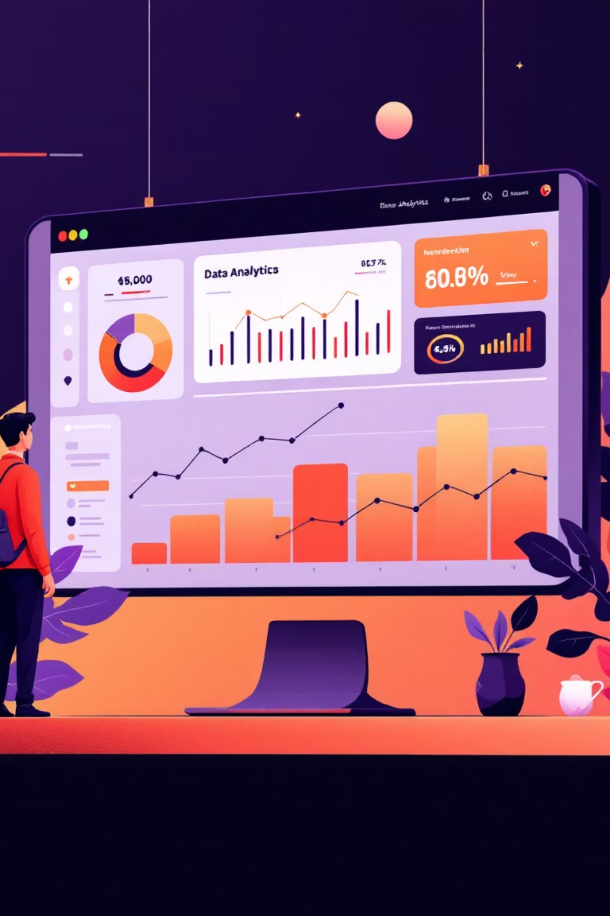
Customer Shopping Behavior Analysis
Uncovering insights from 3,900 purchases to drive strategic decisions

Slide 2
OVERVIEW
Dataset at a Glance
3.9K
18
50
Total Purchases
Data Points
Locations
Transactions analyzed
Features per customer
Geographic coverage
Key Features Tracked
Customer demographics & subscription status
Purchase details & product categories
Shopping behavior & review ratings
Shipping preferences & discount usage

Slide 3


PYTHON
Data Preparation & Cleaning
Data Loading & Exploration
Imported and explored dataset for initial structure and statistics.
Missing Data Handling
Imputed 37 missing review ratings using category medians.
Feature Engineering
Engineered features like age groups and purchase frequency metrics.
Database Integration
Integrated cleaned data into PostgreSQL for further analysis.

Slide 4
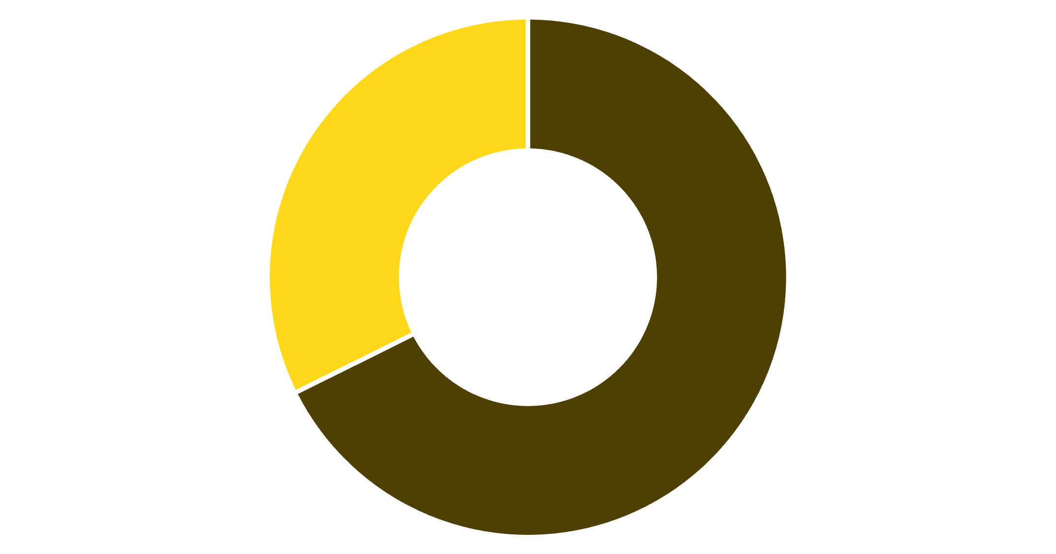
SQL ANALYSIS
Revenue Insights by Gender
Male Customers Drive Revenue
Male shoppers generate 68% of total revenue, more than double female customers.
Total Revenue: $233,081
Male
Female

Slide 5
Top-Rated Products & Shipping Preferences
Highest-Rated Items
3.86/5
3.84/5
3.82/5
3.80/5
Gloves
Sandals
Boots
Hat
Express Shipping
Standard Shipping
Avg spend: $60.48
Avg spend: $58.46

Slide 6
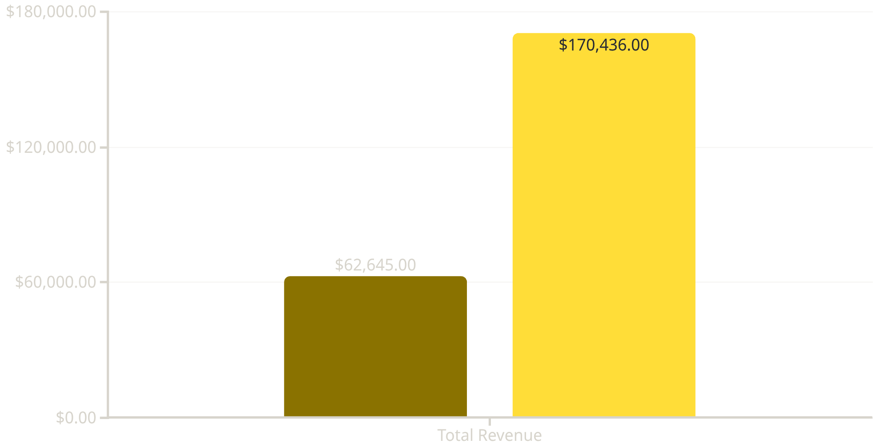


Subscription Status Analysis
Subscribers
Non-Subscribers
27%
73%
Subscribers
Non-Subscribers
1,053 customers
2,847 customers
Similar spending patterns, but non-subscribers dominate revenue through volume

Slide 7


Customer Segmentation & Loyalty
Loyal Customers
Returning
New Customers
3,116 customers (80%)
701 customers (18%)
83 customers (2%)
2-4 previous purchases
First-time buyers
Repeat buyers with 5+ purchases
Key Finding: 958 repeat buyers (>5 purchases) have subscriptions, showing strong correlation between loyalty and subscription status

Slide 8
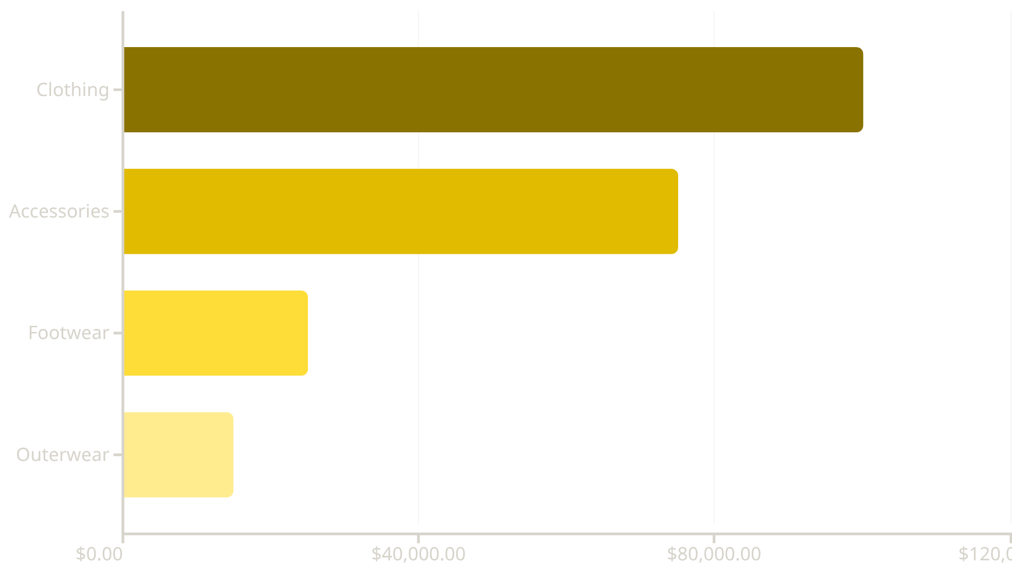
CATEGORY PERFORMANCE
Revenue & Sales by Category
Top Products by Category
Accessories: Jewelry (171 orders)
Clothing: Blouse & Pants (171 each)
Footwear: Sandals (160 orders)
Outerwear: Jacket (163 orders)
Clothing dominates with 1,737 total sales

Slide 9

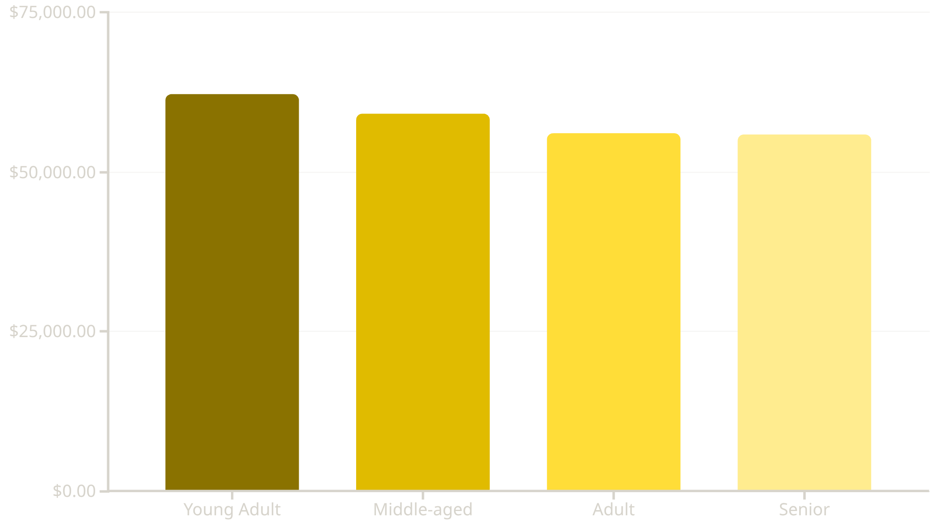
Age Group Revenue Distribution
Young adults lead revenue generation, but all segments show balanced contribution

Slide 10





ACTION ITEMS
Strategic Recommendations
Boost Subscriptions
Loyalty Programs
Review Discounts
Product Positioning
Targeted Marketing
Reward repeat buyers to strengthen the 80% loyal segment
Balance sales boosts with margin control on high-discount items
Highlight top-rated items like Gloves and Sandals in campaigns
Focus on young adults and express-shipping users for maximum ROI
Promote exclusive benefits to convert 73% non-subscribers

